Slide 1
Persistence of three droplets in longer simulation
CPC radius = 0.25 Cohesin width = 0.11
Total time = 0.03 → 0.4 (almost)

Slide 2
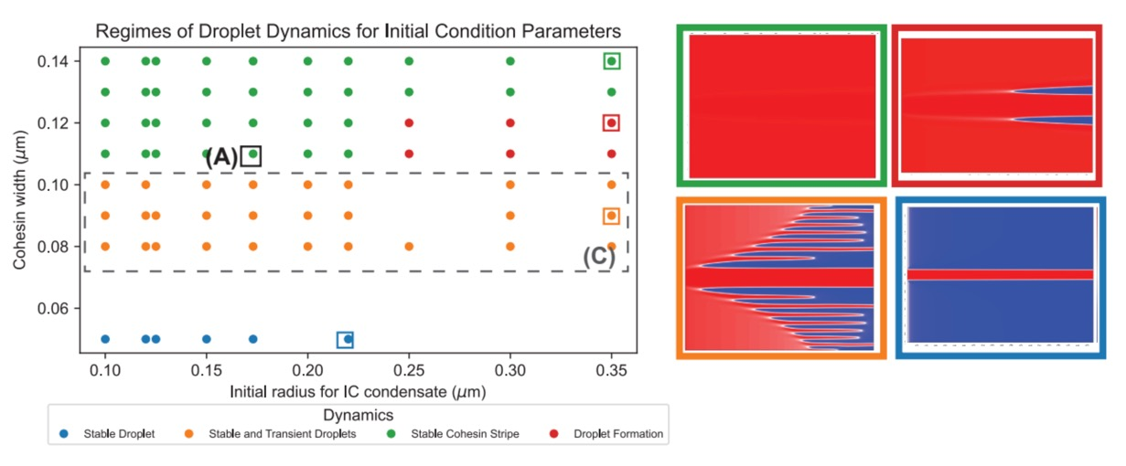
Running the simulation out to t= 0.4 (10x longer)

Slide 3
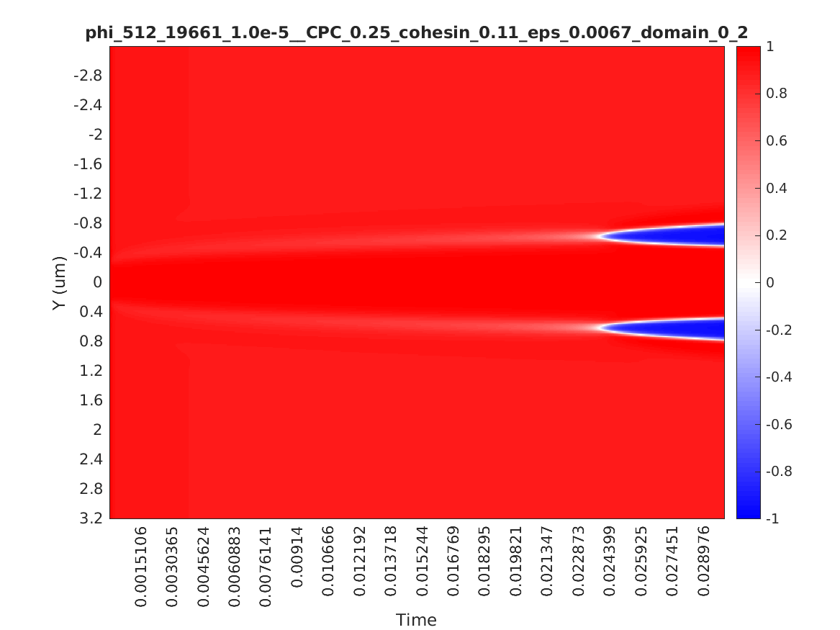
Kymograph of shorter simulation

Slide 4
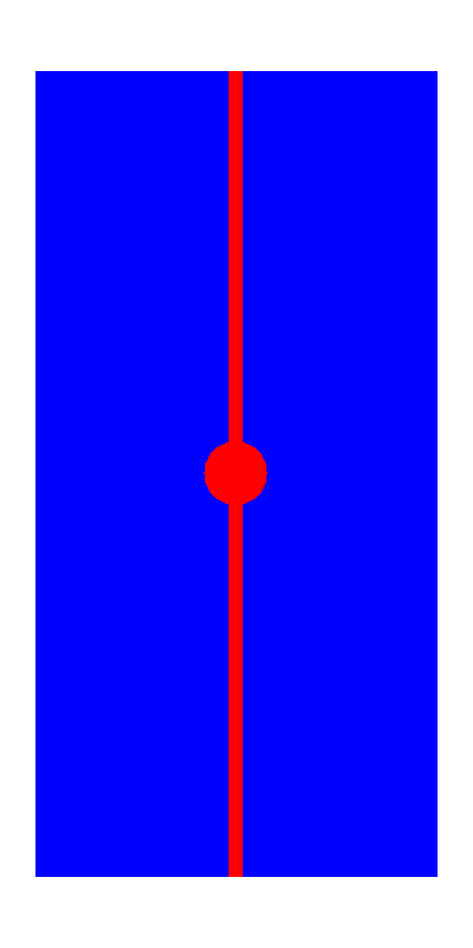
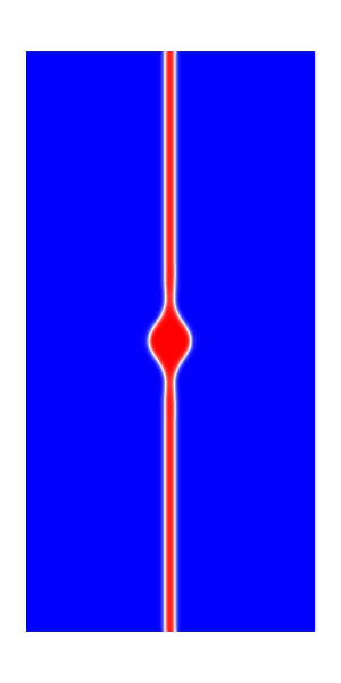
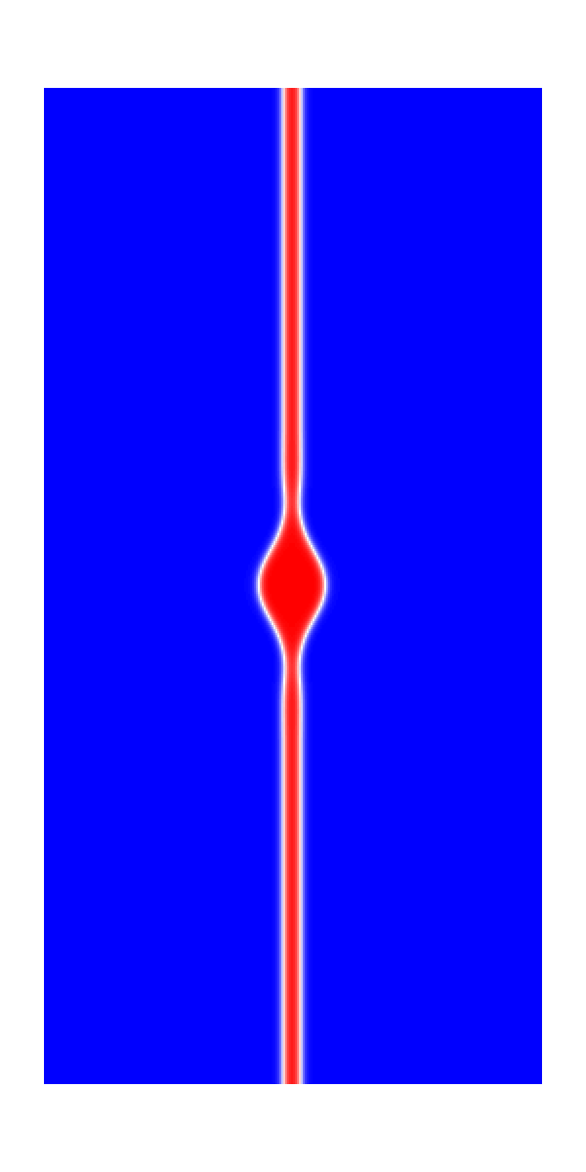
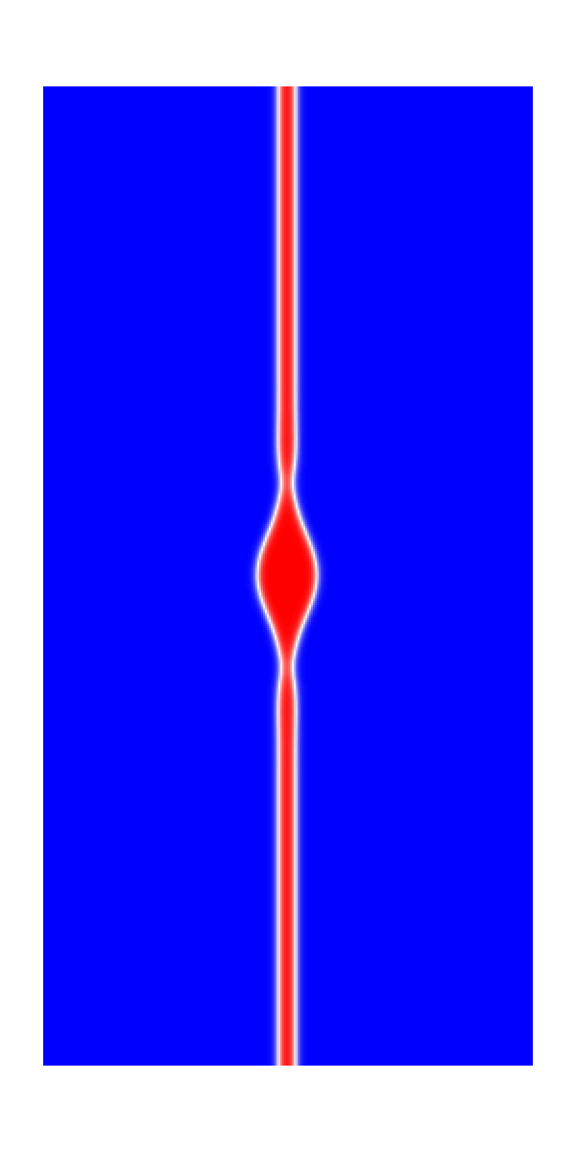
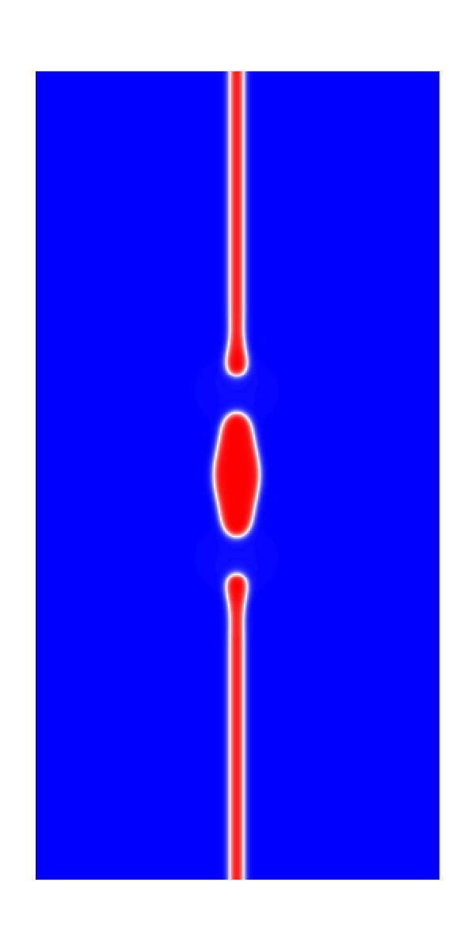
Original simulation (t = 0 to t= 0.03)
T = 0
T = 0.005
T = 0.01
T = 0.02
T = 0.03

Slide 5
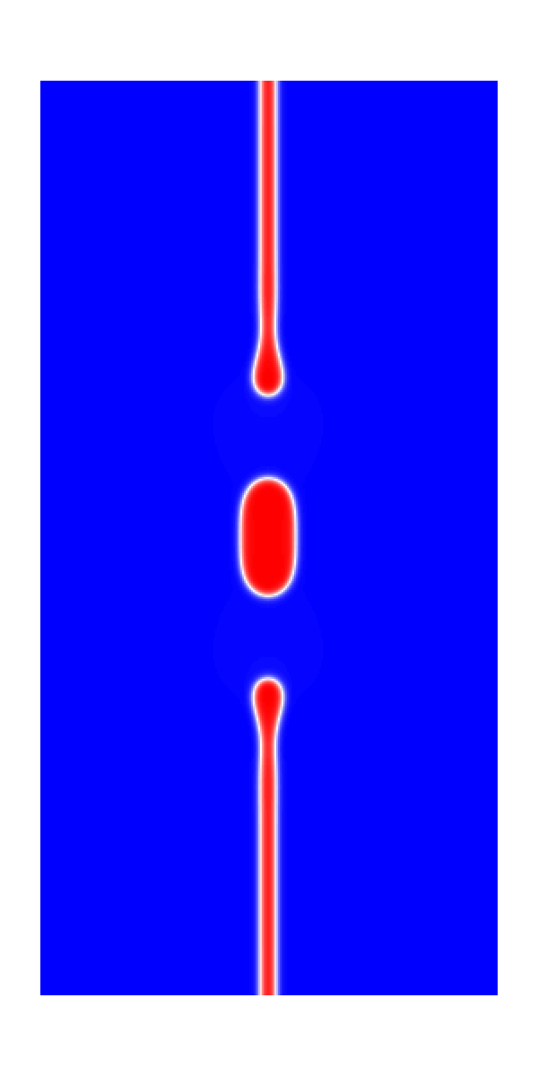
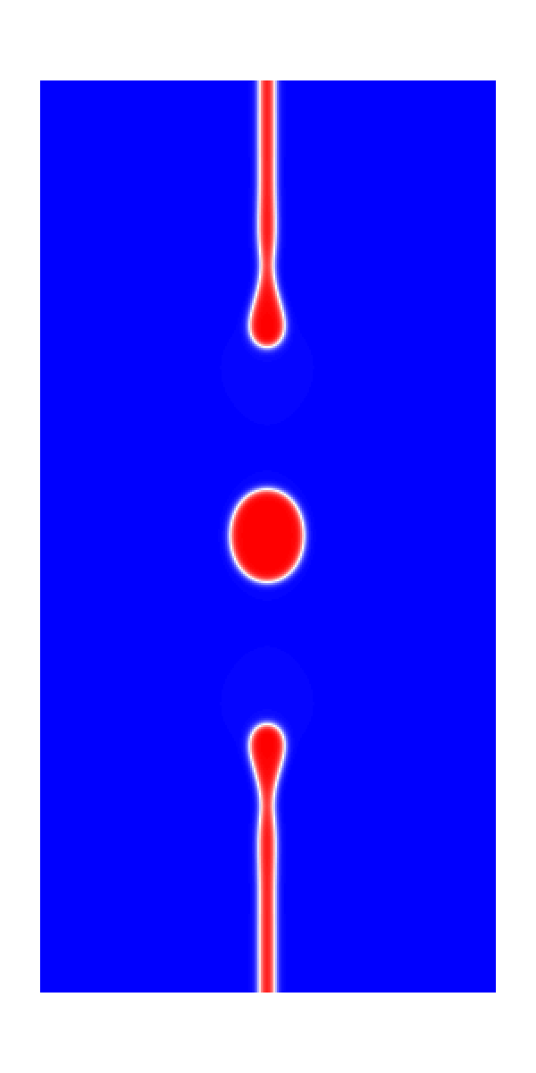
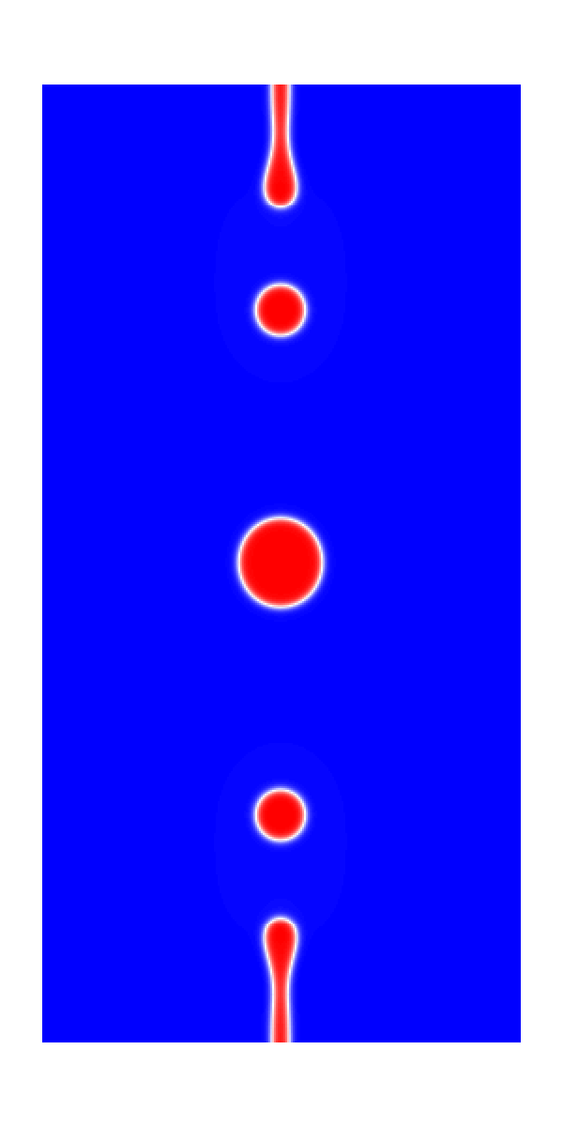
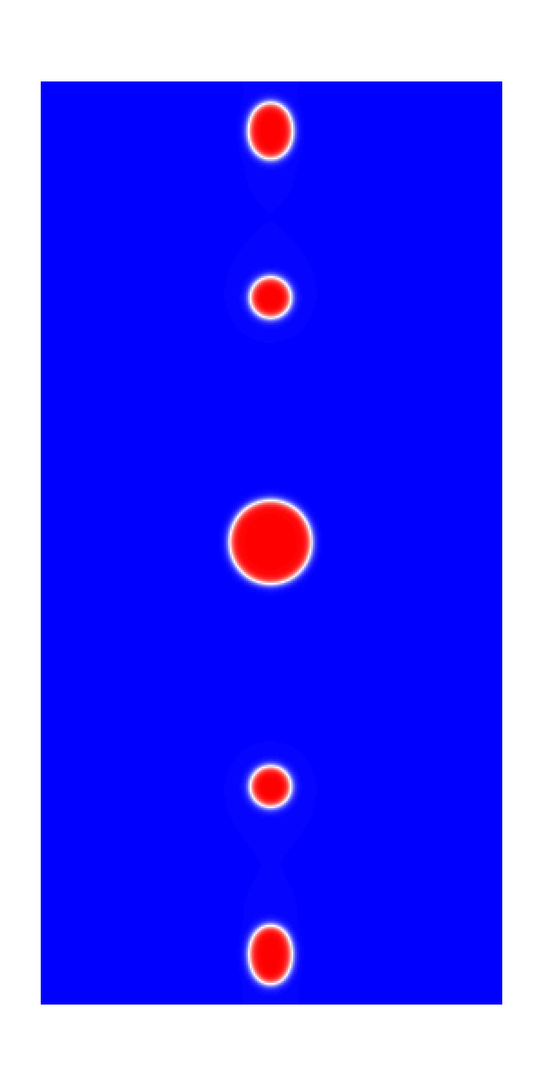
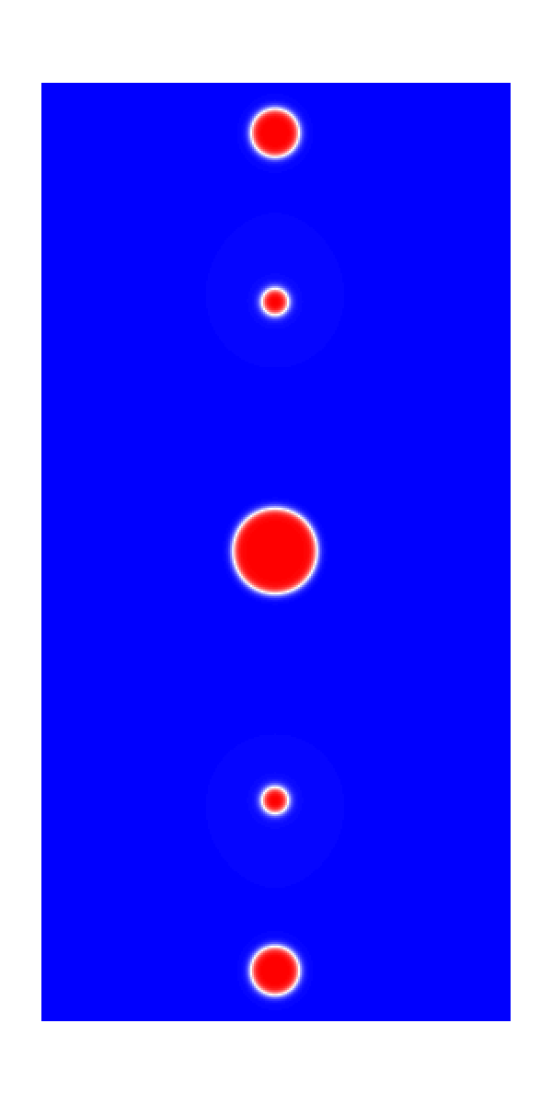
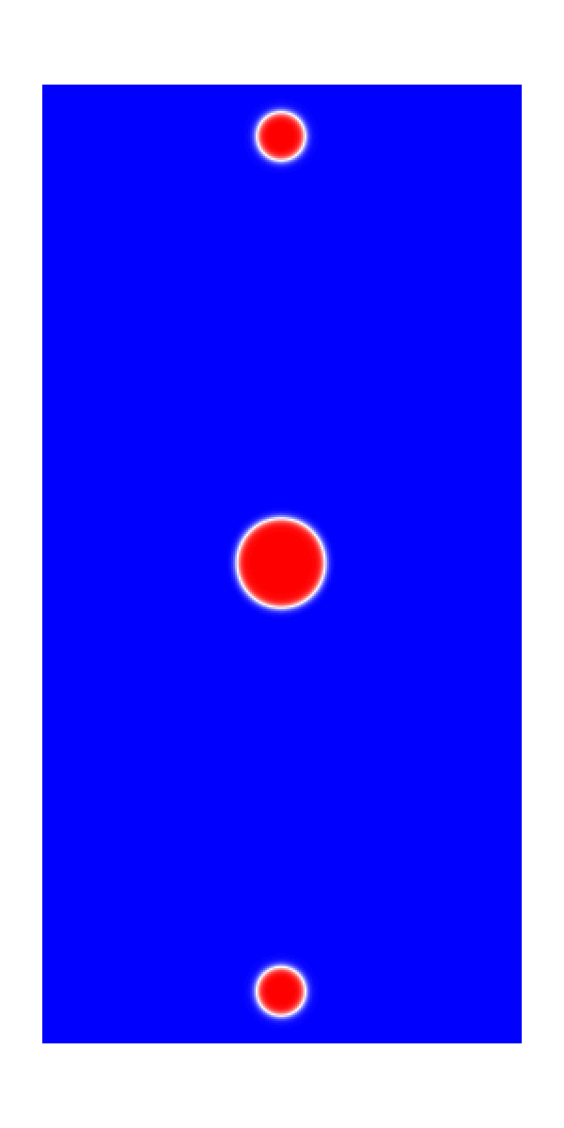
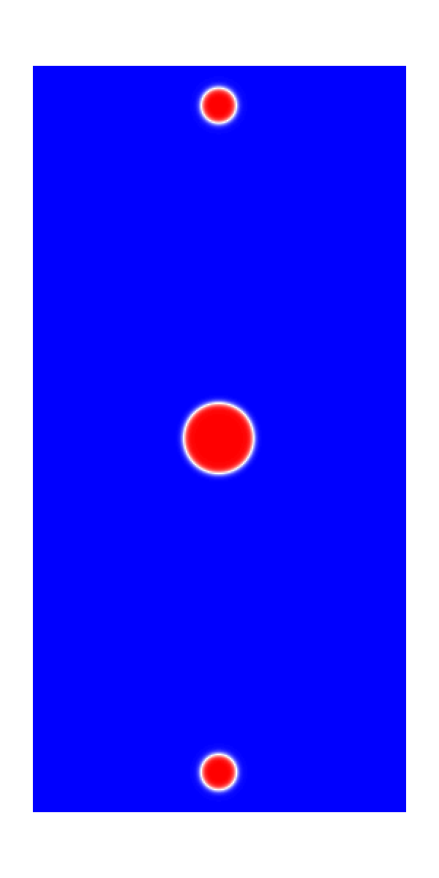
Second half of longer sim (t = 0.05 to t = 0.35)
T = 0.05
T = 0.1
T = 0.15
T = 0.2
T = 0.25
T = 0.3
T = 0.35

Slide 6
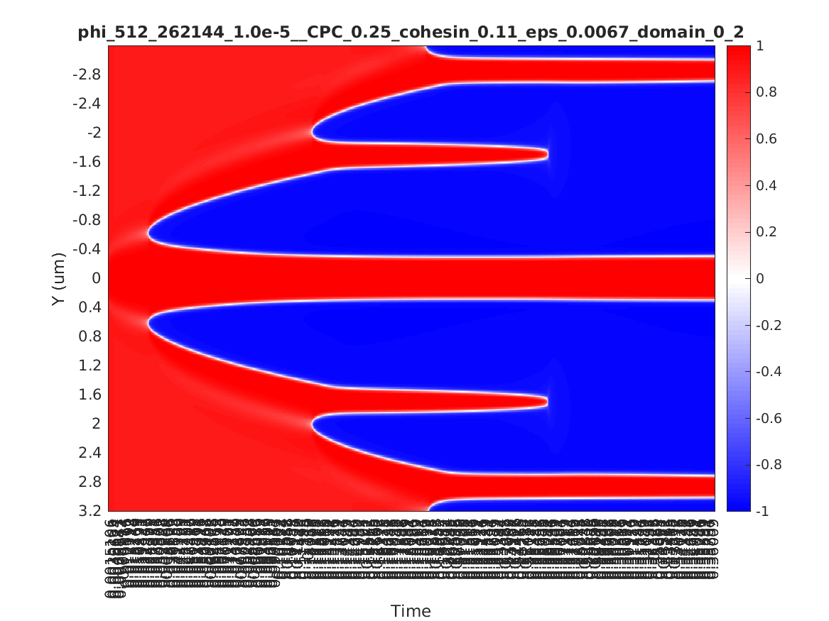
Kymograph of longer sim (t = 0.4)

